Slide 1

Hamlet
A Tragicomedy in Modern World
Drama Presentation

Slide 2


Group Members
Anindita Podder Oishi - 2115931046
Sumaiya Akter Mou - 2215931076
Shanzida Yeasmin - 2215931078
Mehedi Hasan - 2215931080
Afsana - E - Humaira - 2215931082
Mazharul Rahman Mahin - 2215931084
Fazle Rabbi - 2215931086
Takia Samiha - 2215931090
Sanjia Afrin Mim - 2215931092

Slide 3


Slide 4


Slide 5
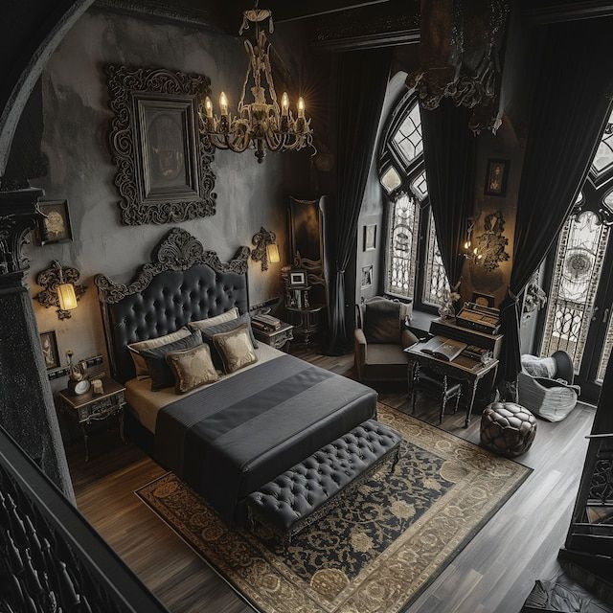

Slide 6


Slide 7


Slide 8


Slide 9


Slide 10
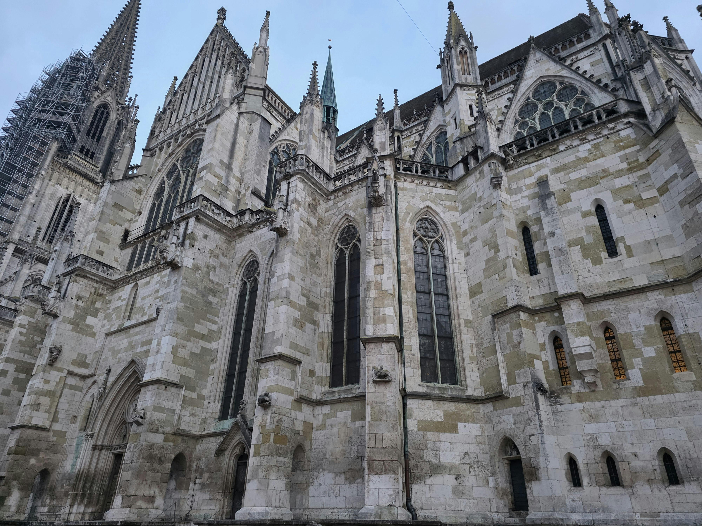

Slide 11



